Slide 1
NTC Inbound 2015
Taiwan
Cincinnati-NTC exchange Program

Slide 2
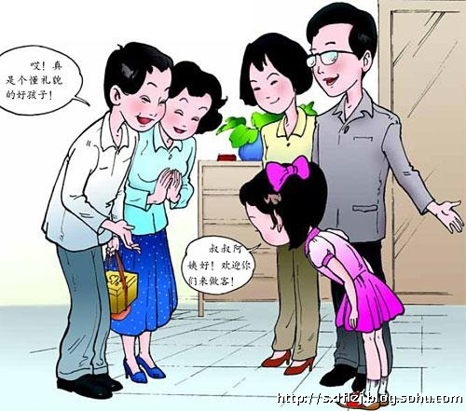
Nǐ hǎo
Chinese Greeting

Slide 3
A brief history of Taiwan - The free china
1624 – The Dutch
1662 – Ming Dynasty / Cheng Cheng-Gong
1895 – Japanese
1945 – Nationalist (KMT) / Chiang Kai-Shek

Slide 4
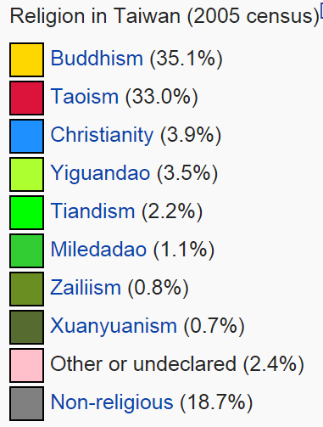
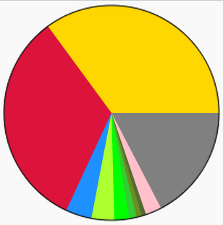
religion

Slide 5
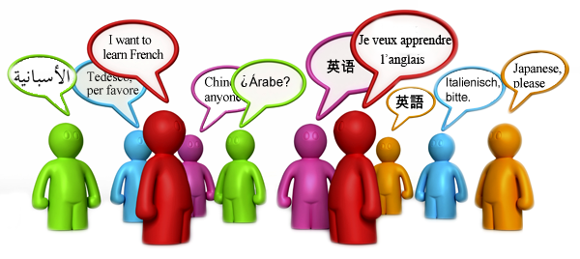
Language
Official Language: Mandarin Chinese
Dialects:
Taiwanese mainly and
some Hakka language

Slide 6
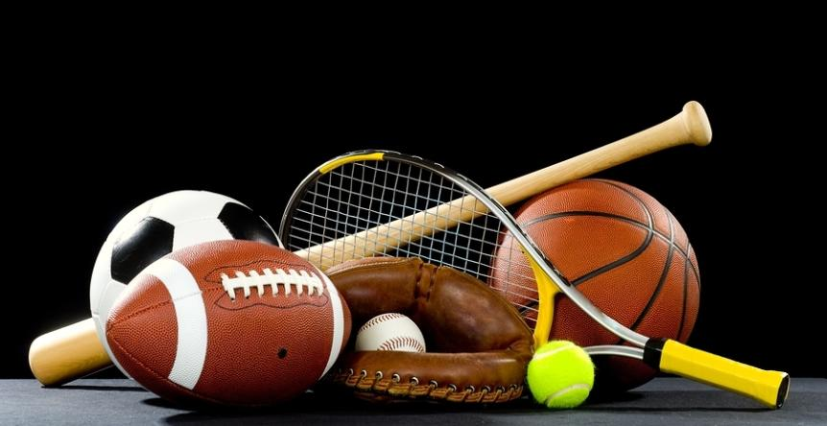
Popular sports
Badminton
Baseball
Basketball
Martial arts
Table tennis
Volleyball…

Slide 7
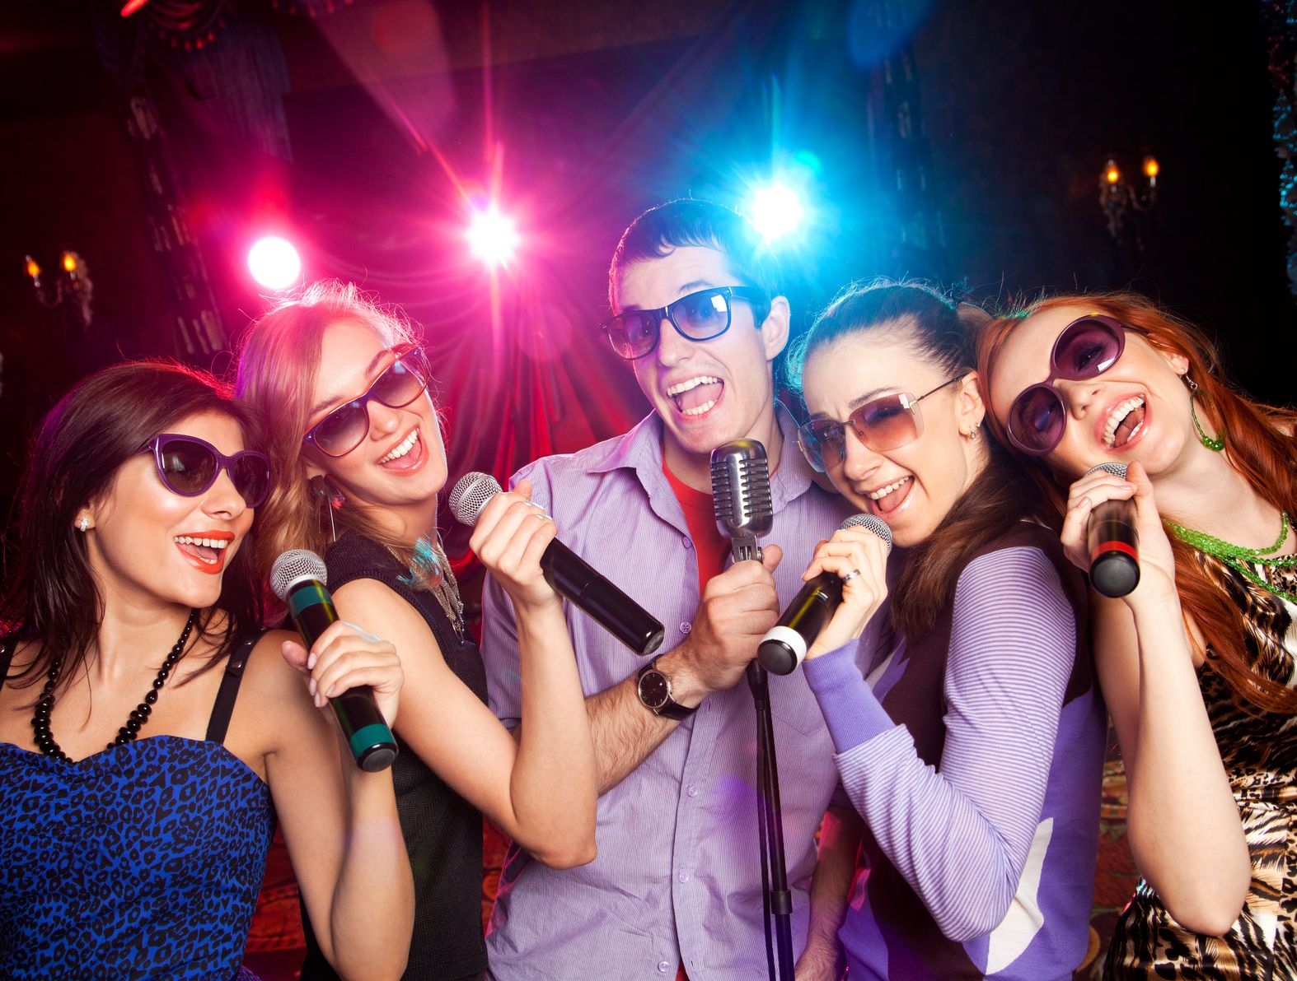
Recreation
#1 Karaoke – KTV
Playing ma-jiang
Watching television
Hot springs
Anime and Manga

Slide 8
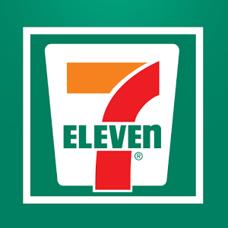
Convenience store culture It’s great to have “Seven”!
Nicknamed “Seven” in Taiwan.
About 5000 stores, the world’s highest density of 7-Eleven per person.
24 hours service and food including:
- Collection of the city parking fee
- Utility bills
- Traffic violation fines and credit card
payment.

Slide 9
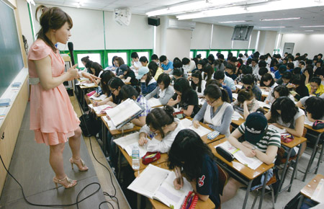
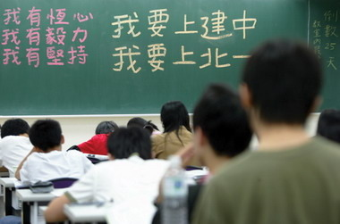
Cram school culture
It’s called “Bushi Ban” in Taiwan.
Nearly all students attend some sort of cram schools, whether for mathematics, computer skills, English, other foreign languages, or exam preparation (college, graduate school, TOFEL, GRE, GMAT, SAT, etc.

Slide 10
SOME GENERAL DIFFERENCES BETWEEN TAIWANESE AND AMERICAN CULTURES.
Conception Of the Self
Taiwanese
Americans
Collectivist: Higher value placed on group cooperation and individual modesty.
Individualist: Higher value placed on self-reliance. Self-promotion is more accepted. High value placed on "freedom" from externally imposed constraints.
Social Relationships
Taiwanese
Americans
Formal, hierarchical. People most comfortable in the presence of a hierarchy in which they know their position and the customs/rules for behavior in the situation.
Informal, egalitarian. People most comfortable with their social equals; importance of social rankings minimized.

Slide 11
SOME GENERAL DIFFERENCES BETWEEN TAIWANESE AND AMERICAN CULTURES.
Obligation
Taiwanese
Americans
Relationships with other people involve reciprocal obligations.
People avoid interdependent relationships and situations that might entail long-term obligations.
Friendship
Taiwanese
Americans
Small number of close, lifelong friends who feel deeply obligated to give each other whatever help might seem required.
Large collection of "friends" and acquaintances which changes over time and involves only limited mutual obligations.

Slide 12
SOME GENERAL DIFFERENCES BETWEEN TAIWANESE AND AMERICAN CULTURES.
Task vs. Relationship Orientation
Taiwanese
Americans
Relationship-oriented: Maintaining a harmonious relationship has priority over accomplishing tasks.
Task-oriented. Relationships are less important than getting the work done.
Harmony vs. "Truth"
Taiwanese
Americans
Avoid direct confrontation, open criticism, and controversial topics. Concern maintaining harmony and with "face."
Willing to confront directly, criticize, discuss controversial topics, press personal opinions about what they consider "the truth. Little concern with "face."

Slide 13
SOME GENERAL DIFFERENCES BETWEEN TAIWANESE AND AMERICAN CULTURES.
Time Consciousness
Taiwanese
Americans
Relatively more attention to the past and to the longer-term future.
Less interested in the past; eye on near-term future.
Role of laws, rules, and regulations
Taiwanese
Americans
More faith in personal relationships than in written rules and procedures for structuring interactions.
Written rules presumably apply to everyone and are assumed to produce fair, reasonable procedures and decisions.

Slide 14
Giving and Receiving Gifts
It would be a nice gesture to bring small gift to welcome them when they come.
Chinese people usually do not unwrap the gifts when the receive them. It is considered polite in Chinese culture to open the gifts after you leave. When you receive a gift from Chinese people, do not open them unless they insist, or you may simply say, "Can I open it?"

Slide 15
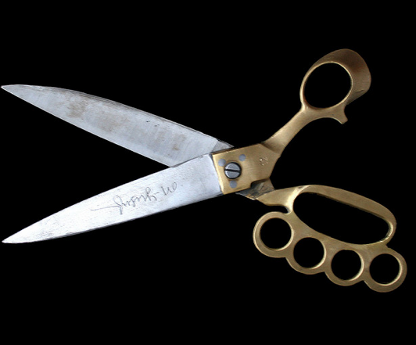
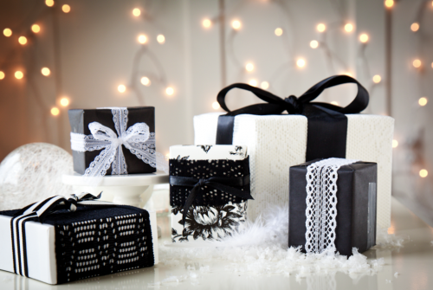
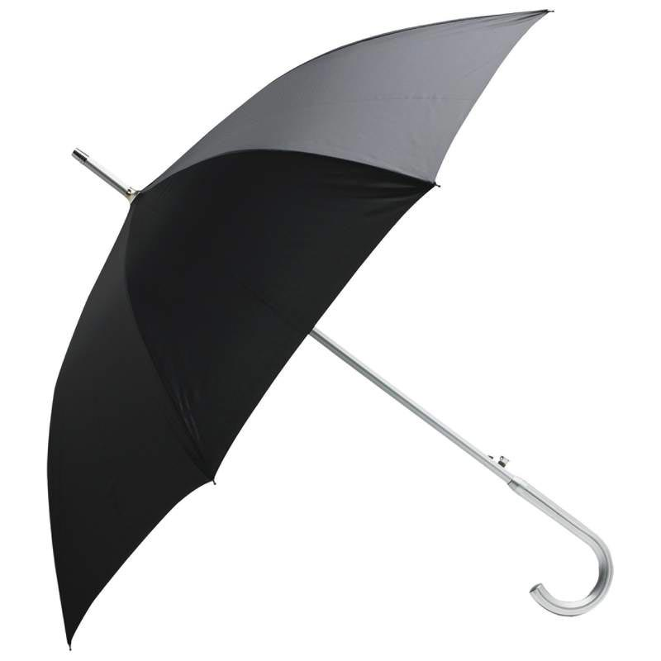
Giving and Receiving Gifts
When wrapping gifts, avoid using white or black wrapping paper, and avoid wrapping elaborately. Consider red or other festive colors.
Avoid gifts like knife, clock, scissors, umbrella.

Slide 16
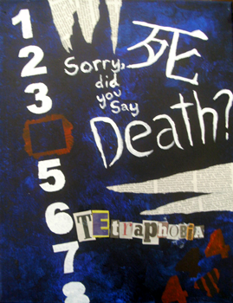
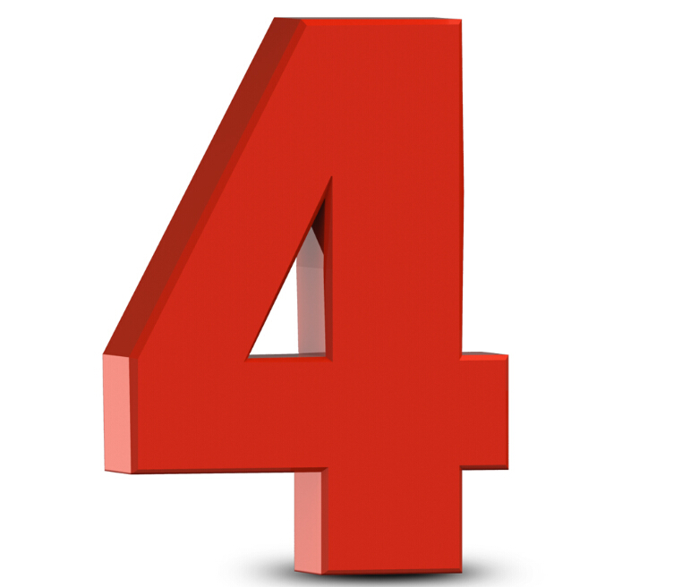
Giving and Receiving Gifts
Even numbers are considered good luck Except # 4
It is appropriate to send one gift or send them in pairs.

Slide 17
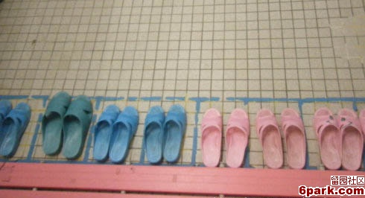
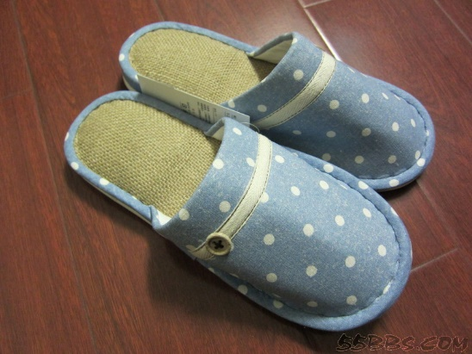
at Home
Taiwanese remove their shoes when entering someone’s home.
Taiwanese wear slippers inside the house.

Slide 18
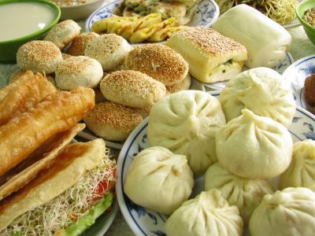
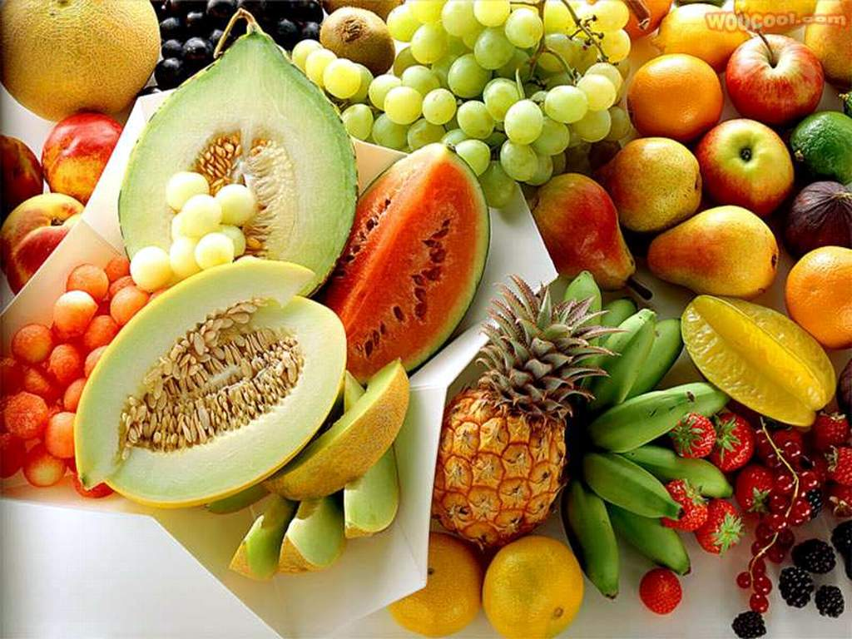
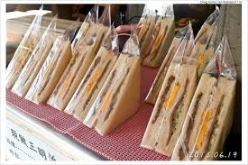
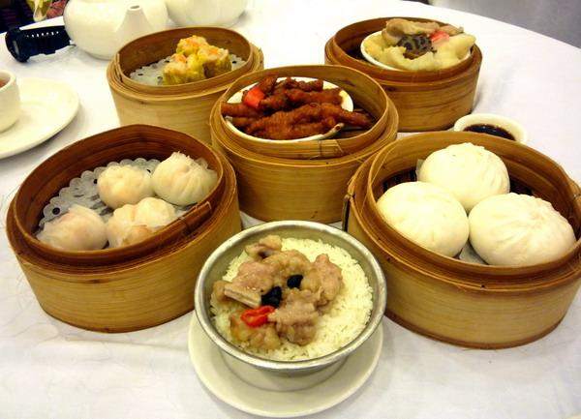
Why not let the students try something we all like here in Cincinnati, USA?
Steak, it’s what for dinner!

Slide 19
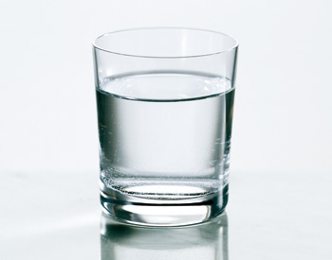
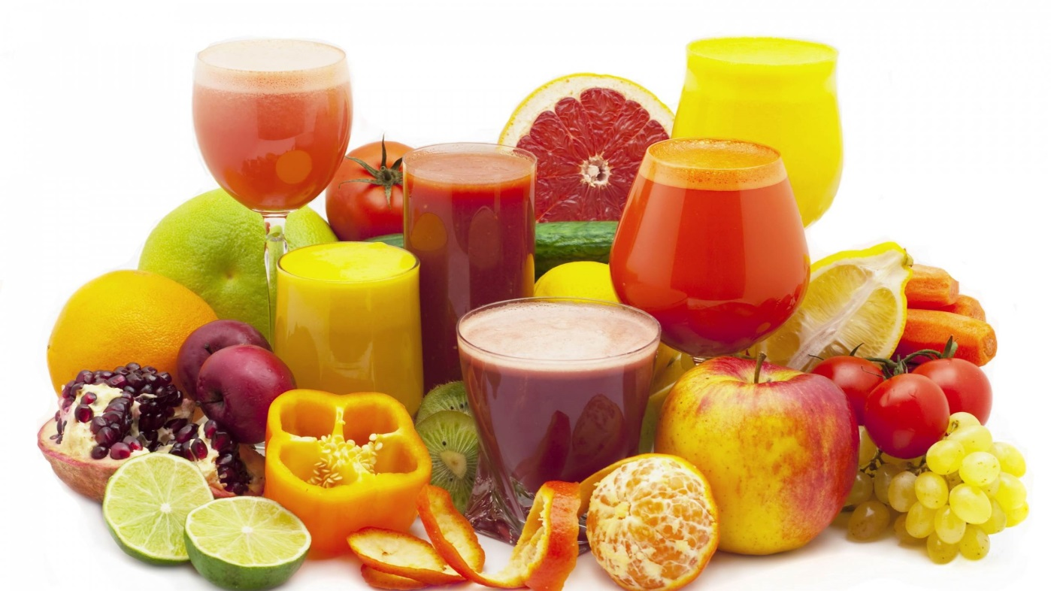
Taiwanese prefer drinks without ice.
Hot tea is common.
Juices and fruits.

Slide 20
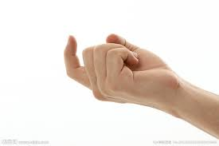
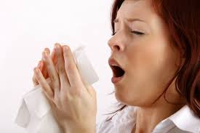
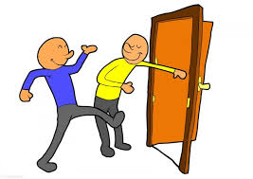
Do's and Don'ts
Do not overreact when asked personal questions regarding marital status, family, age, job or income, because this is done to seek common ground. Just humor it.
Do not back slap, hug or put your arm around someone’s shoulder, which will make a Chinese feel uncomfortable, since they do not like to be touched by strangers. Of course you can do so if you are familiar with each other.
Chinese do not like body contact, such as hugs and kisses. They usually nod, bow or shake hands.
Chinese do not verbally express thanks or apologies as often as American do, such as when they sneeze, burp, or yawn in public.
Chinese do not hold door for people.

Slide 21
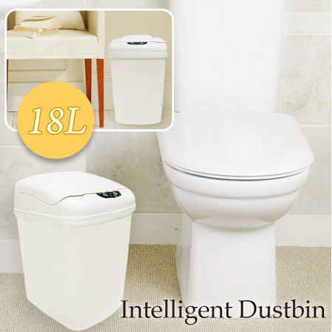
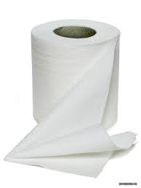
Bathroom Issues
Go over with the students how to use the shower and how you do things at home.
Tell them it is okay to throw the paper in the toilet.

Slide 22
Exchange Money?
Students should already have their spending money with them. If for some reasons they need to exchange money, please contact the committee. We can help.
Please keep your receipt together for our overall study for economic impact in the end.

Slide 23
How about the Weather?
Fact: The coldest winter in Taiwan is about 50 °F. People from Taiwan are not used to cold weather.
Solution:
Place a portable heater, if you have one, in their room. Extra blanket would be nice.
Prepare some hot ginger tea for them to help with the circulation

Slide 24
good
Not good
Bù hǎo
Hǎo

Slide 25
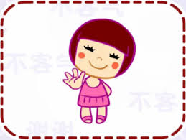
Thanks. / you’re welcome.
Xiè xie / bú kè qì

Slide 26
Thank you! Q & A

